Slide 1
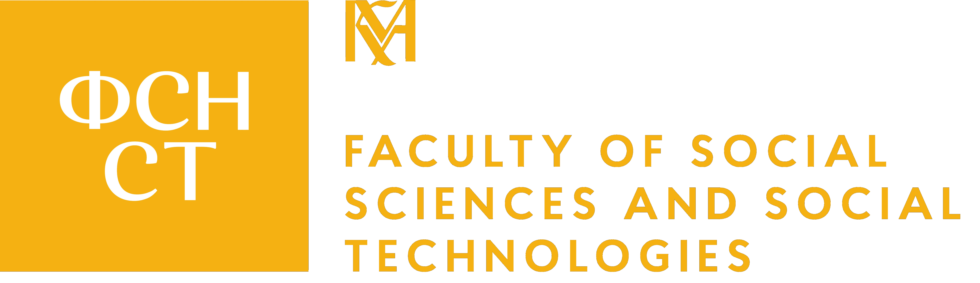

Everyone has an opinion on Russia.
Few have the tools to understand it.
NaUKMA invites you to apply for an online certificate program:
Russian Studies:
Power, Coercion, and Society in Russia
Study contemporary Russia with Ukrainian and international scholars who have been critically researching the regime, empire, and society of Russia.

Slide 2

Online
Proposed courses
Audit a single course or take three to earn the certificate.
Russian Society and Identity:
Values, Practices, and Everyday Life
Authoritarian Political Regimes and Everyday Authoritarianism in Russia
Russian Colonialism
and the Peoples of Russia
An analysis of Russia as a historical and contemporary imperial formation, focused on its colonial practices in time and space and its relations with non-Russian peoples. The course traces the expansion of the Russian state, the colonisation and governance of diverse ethnic and regional groups, and the persistence of colonial hierarchies. It also examines the history and prospects of movements for autonomy and independence, as well as centrifugal tendencies within the Russian Federation — including the economic position of colonised peoples — and draws on postcolonial approaches to read identity, inequality, and resistance. Representatives of national movements join as guest speakers.
An examination of the social structure of contemporary Russia through the lens of identity, values, and everyday practices. The course considers how social norms, cultural patterns, and historical legacies shape individual and collective identities, and how those identities interact with political power and state narratives. It engages with the role of imperial legacies, nationalism, and chauvinism in shaping social attitudes — including the normalisation of hierarchical and exclusionary worldviews — and traces the dynamics of everyday life under political constraint, alongside the vectors of social change in Russia today.
An analysis of authoritarian rule in Russia at two levels: the formal architecture of the regime and the everyday practices through which it is reproduced. The course traces socio-political autocratisation under Vladimir Putin — the re-centralisation of state power, the capture of civil society — and develops the concept of "everyday authoritarianism": the routines of compliance, negotiation, and resistance through which ordinary citizens encounter the state. It also examines how authoritarian governance shapes public support for, and acquiescence to, Russia's war against Ukraine, including mechanisms of mobilisation, propaganda, and social control.
4 ECTS · Spring 2027
3 ECTS · Fall 2027
4 ECTS · Spring 2027

Slide 3
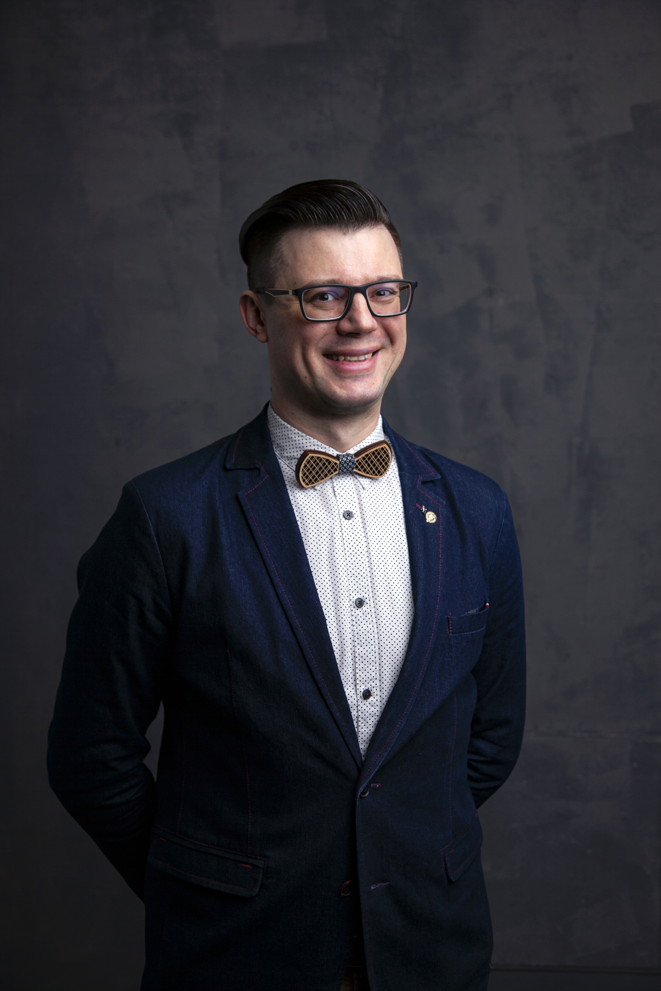
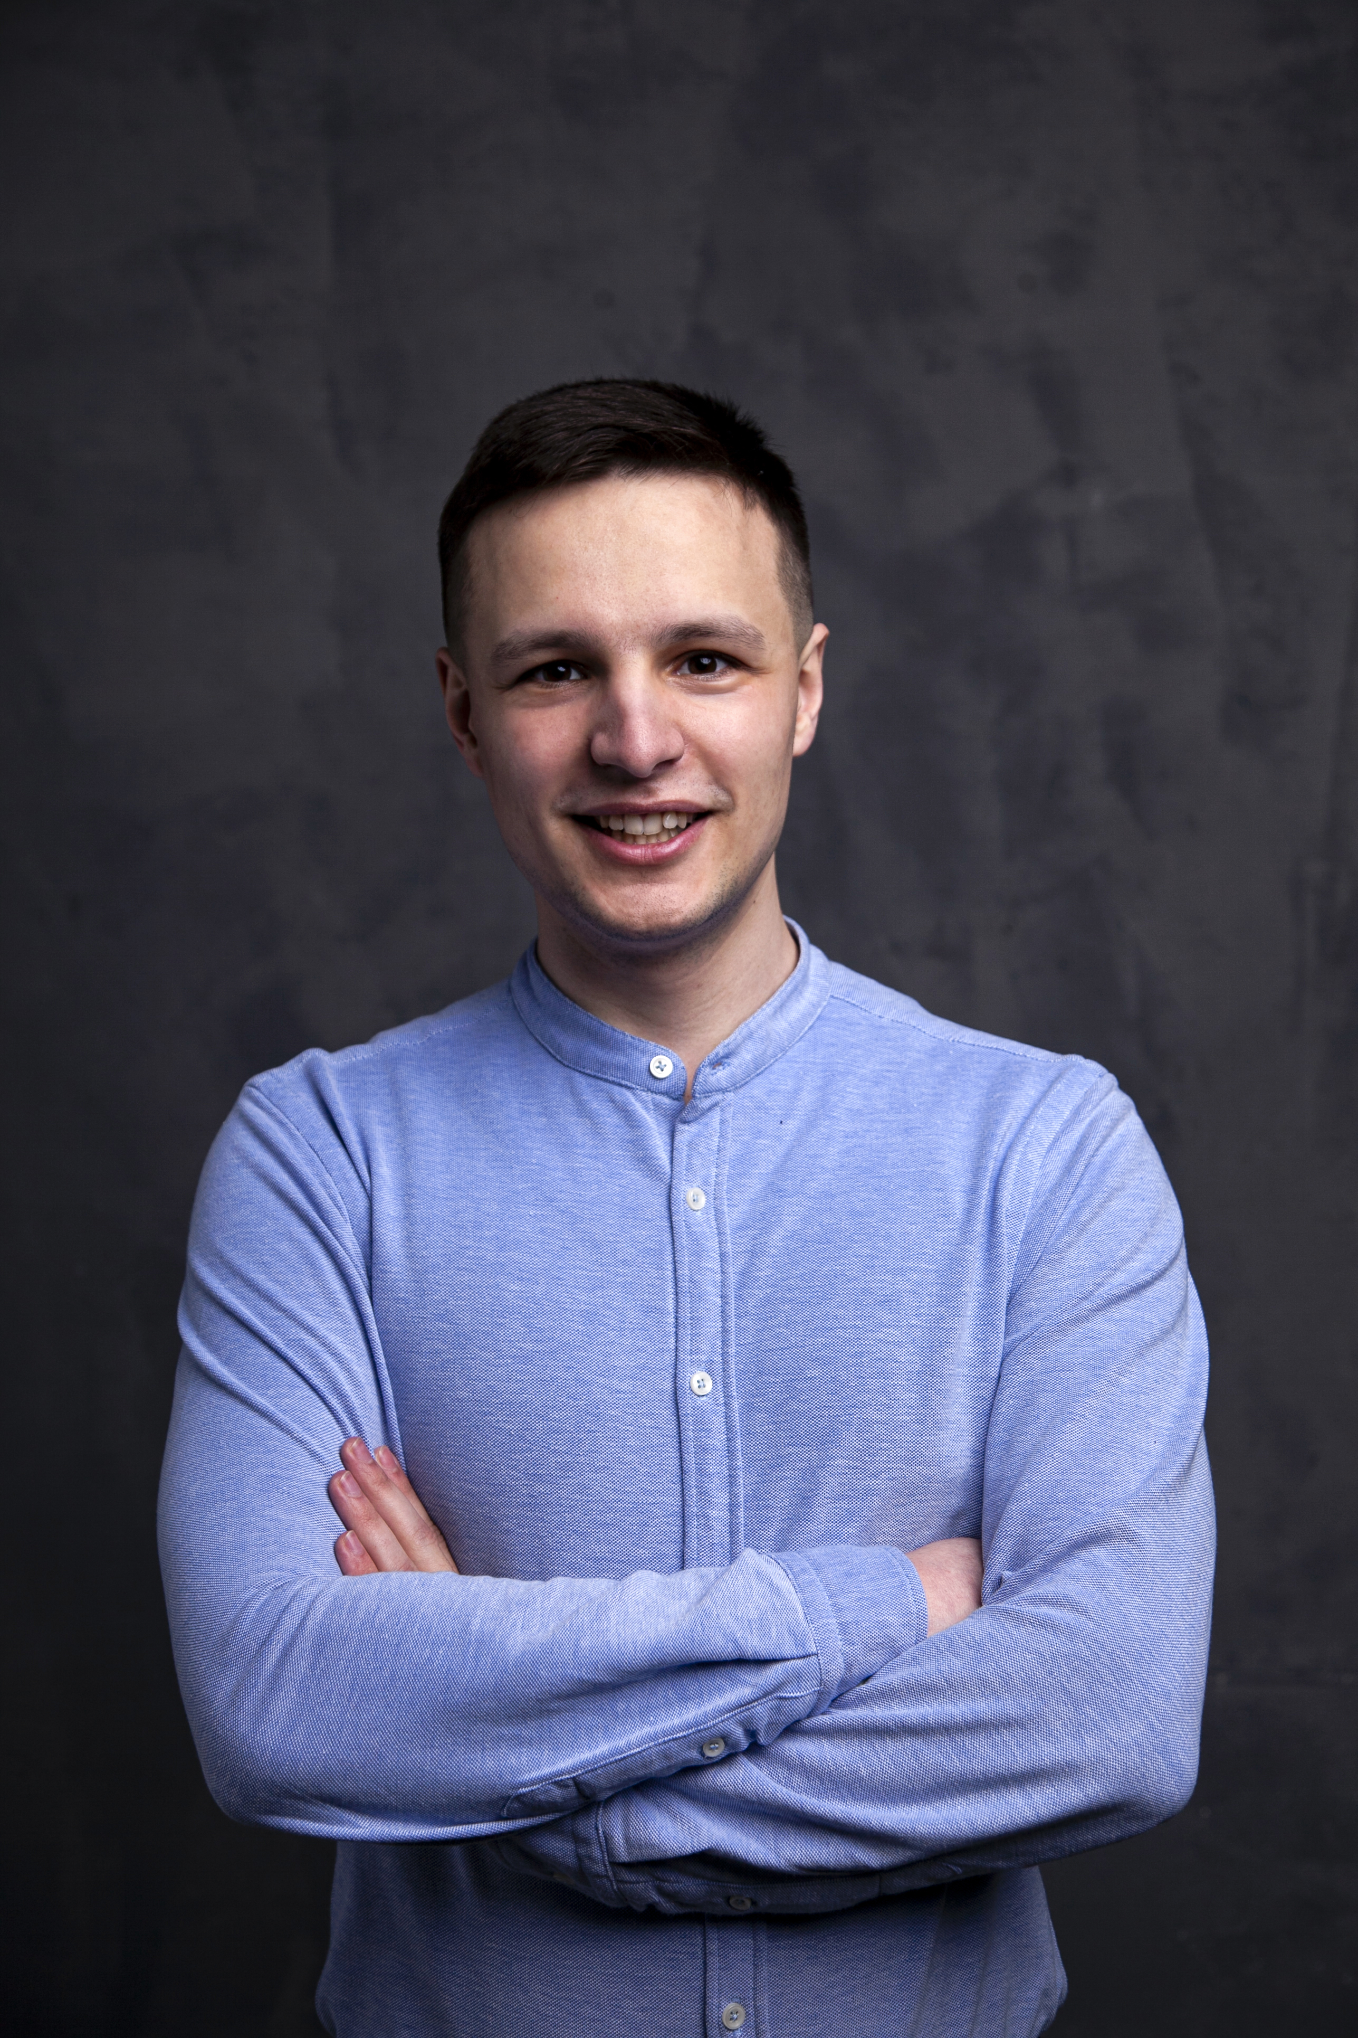
Who the program is for
Anton Suslov
Designed for master’s-level students. Senior undergraduates with a strong interest are also encouraged to apply.
Built for social sciences, humanities, and law fields, but applicants from other disciplines are welcome — interdisciplinary backgrounds are a strength.
Basic familiarity with international relations theory and modern world history is an advantage but not a formal requirement.
Dr Maksym
Yakovlyev
Head, Department of International Relations
Director, School for Policy Analysis (NaUKMA)
PhD in Political Sciences
Senior Lecturer, Department of International Relations
Senior Analyst, School for Policy Analysis (NaUKMA)
Course convenors

Slide 4
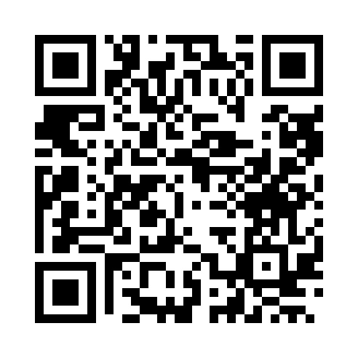
Apply now.
SCAN TO APPLY
Scan the code, fill the form, join the program.
1 ECTS CREDIT= 85 USD · 80 EUR
Students from NaUKMA partner universities may participate free of charge.
Contact int_students@ukma.edu.ua to learn more

